Slide 1
Global Economic and
Demographic Trends Analysis
Name : Karthick .T
Date : 21-06-2025

Slide 2
Project Overview
This project Analyze global GDP, population, literacy, migration, and health indicators
It Identify trends, patterns, and regional differences
Tools : MYSQL & POWER BI

Slide 3
Dataset Description
Countries World (SQL Database)
Source: Provided SQL file
Includes country-level data like:
Population, Area, Population Density
Net Migration, Infant Mortality Rate
GDP per Capita, Literacy Rate
Phones per 1000 people, Climate
Coastline Ratio, Arable/Other Land %
Birthrate, Deathrate
Sector-wise GDP: Agriculture, Industry, Services
Population Per Country(CSV File)
Population data from 1960 to 2017
Contains Country Name, Code, and various population indicators
Meta Data (CSV File)
Country details like:
Region, Income Group, and Special Notes
GDP by Country 1960–2016 (CSV File)
GDP data across years
Includes Country Name, Code, and GDP indicators

Slide 4
Data Cleaning
Handled Missing Values
Removed Inconsistencies in Population and GDP data
Renamed columns for consistency
Removed nulls and junk values
Removed global/region summary rows like 'World’
Fixed country names, trimmed whitespaces
Converted raw values to readable format:
- Birthrate × 1000
- Literacy × 100
- Deathrate × 1000
-Checking All Columns Formats

Slide 5
Unpivoting Data
Data Modeling
GDP and Population were in wide format (Year columns)
Unpivoted to long format: [Country, Year, Value]
Renamed columns to GDP, Year, Country, Population
Merged:
-- GDP + Population (on Country, Year)
-- Country Info + Meta Data (Region, Income Group)
Relationships set in Model View

Slide 6
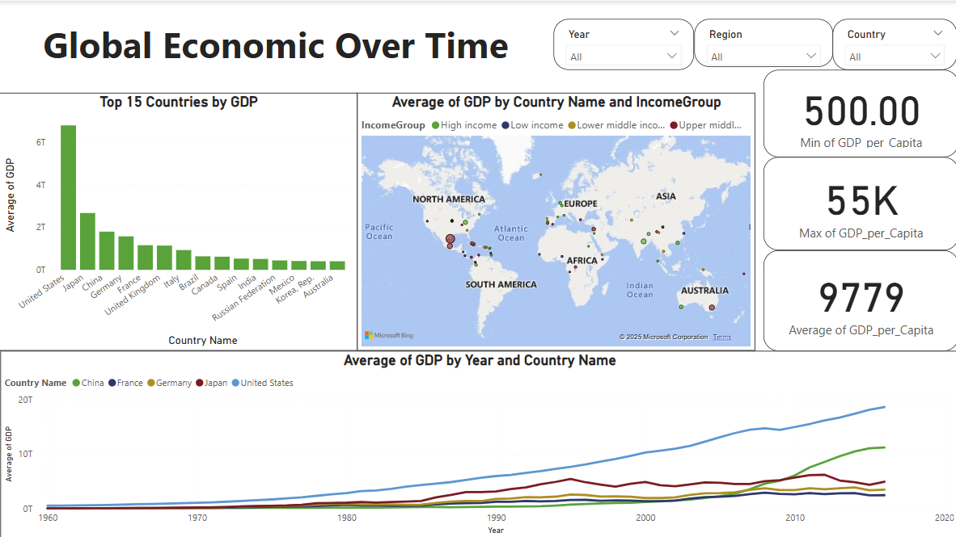
Dashboard Overview

Slide 7
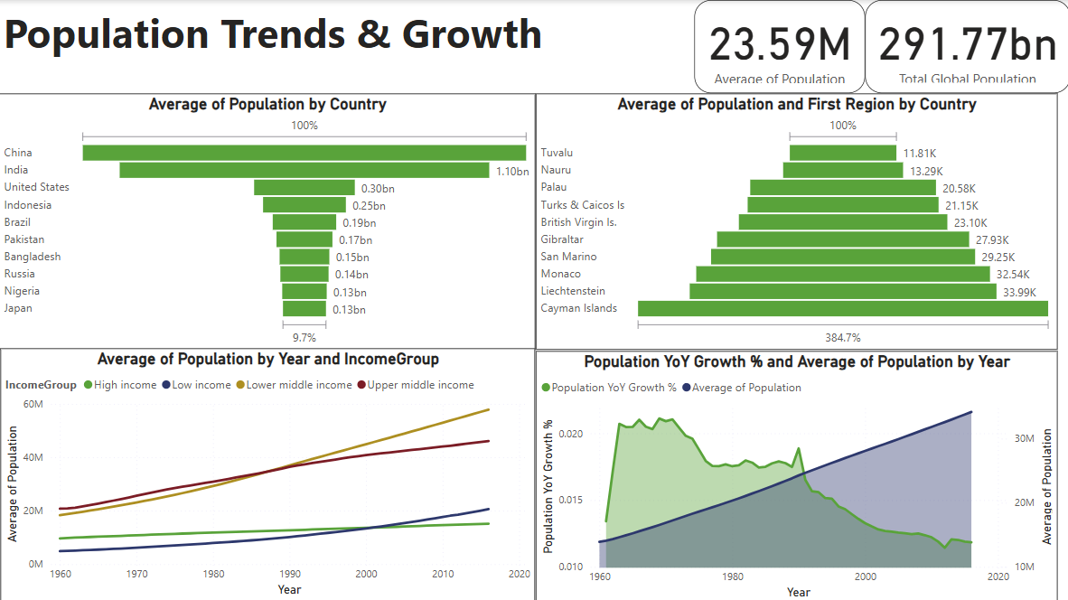

Slide 8
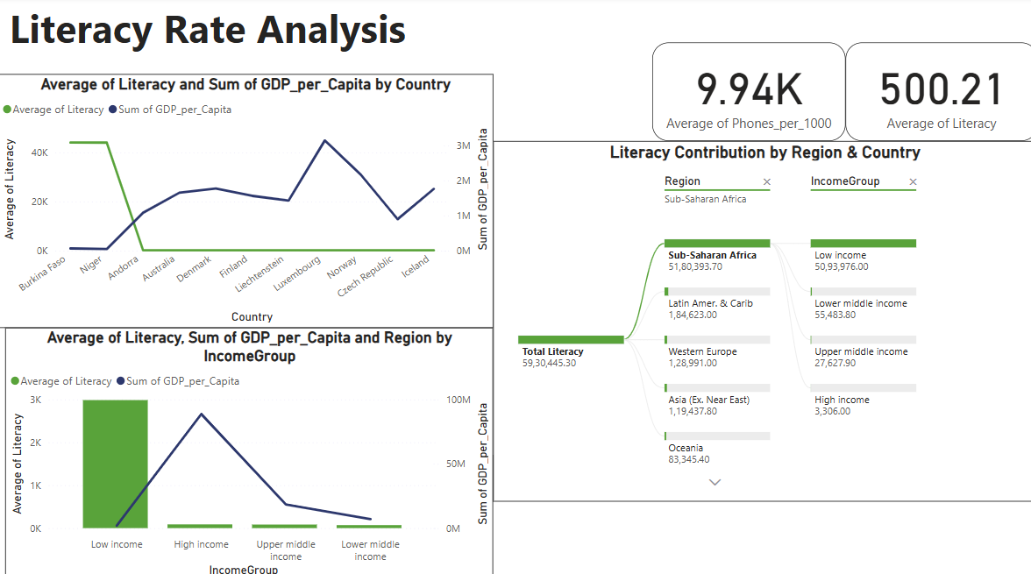

Slide 9
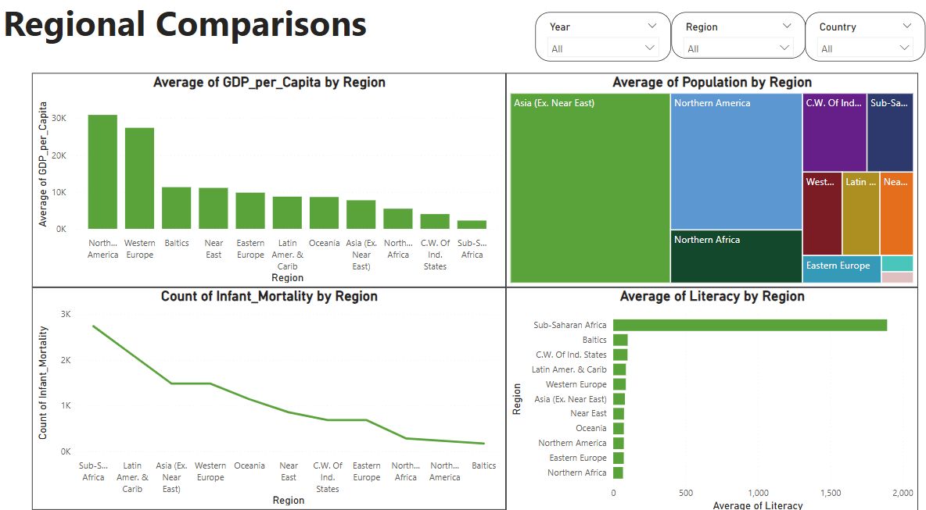

Slide 10
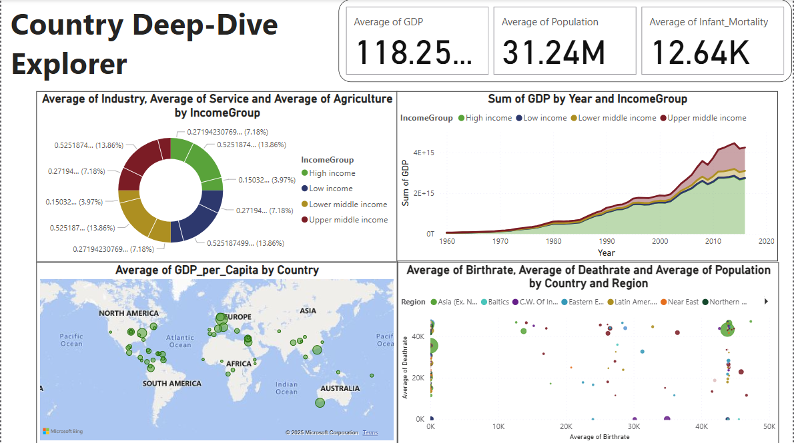

Slide 11
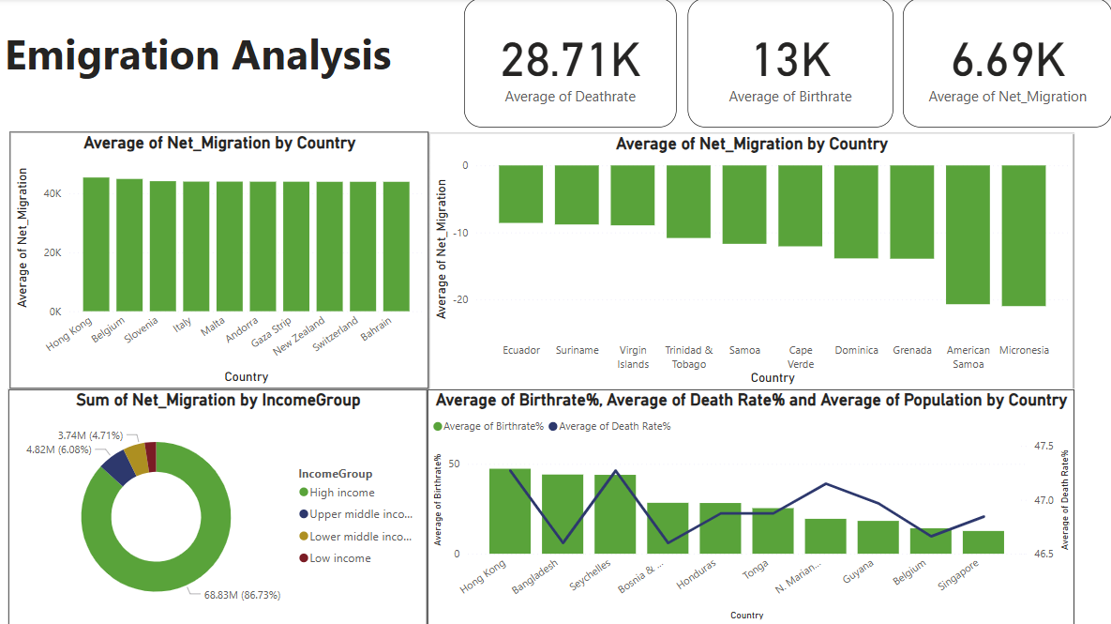

Slide 12
Key Insights
GDP Growth is Uneven: A small group of high-income countries contributes to most of the global GDP. The U.S. leads consistently, while China has shown sharp growth post-2000.
GDP per Capita Gap: Countries with lower GDP per capita remain in the low-income group despite global economic growth — highlighting a widening inequality.
Population is Heavily Concentrated: China and India together account for a significant share of global population.
Growth Rate is Slowing: Year-on-year population growth has decreased globally after peaking in the 1970s, especially in high-income countries.
High GDP = High Literacy :Countries like Luxembourg and Norway show that richer nations have stronger literacy levels.
Niger & Burkina Faso Lag :These countries show extremely low literacy, highlighting educational challenges in low-income regions.

Slide 13
Key Insights
Sub-Saharan Africa Lags Behind: The region has the highest infant mortality and the lowest literacy rates.
North America and Europe Excel: These regions maintain low infant mortality and high literacy, reflecting advanced healthcare and education infrastructure.
Country-level Gaps Are Clear: Some countries show high GDP with low-population, others show low GDP with very high population — highlighting imbalance in economic output.
Mortality & Fertility Still High in Some Regions: Countries with high birth and death rates are mostly low-income, showing ongoing development needs.
Migration Reflects Economic Opportunity: High net migration occurs in countries with high GDP per capita, while lower-income countries often show net outflow.

Slide 14
Conclusion
Economic Power Is Unevenly Distributed: A few high-income countries (notably the U.S., China, and Japan) account for the majority of global GDP , while many nations still operate at subsistence levels of per capita income.
Population Growth Is Concentrated: Most of the world's population growth since 1960 has come from lower- and middle-income countries, especially in Asia and Sub-Saharan Africa. Meanwhile, growth in high-income nations has slowed or reversed.
Literacy Is Closely Tied to Wealth: There is a strong correlation between GDP per capita and literacy rate. Regions like Sub-Saharan Africa remain behind due to systemic education and economic barriers.
Migration Reflects Economic Disparities: Countries with strong economies show high
net in-migration, while others face population outflow — indicating global push-pull dynamics.
Health and Mortality Gaps Persist: Despite global progress, infant mortality and death rates remain high in certain regions, pointing to gaps in healthcare access and development.

Slide 15

THANK YOU

